Slide 1
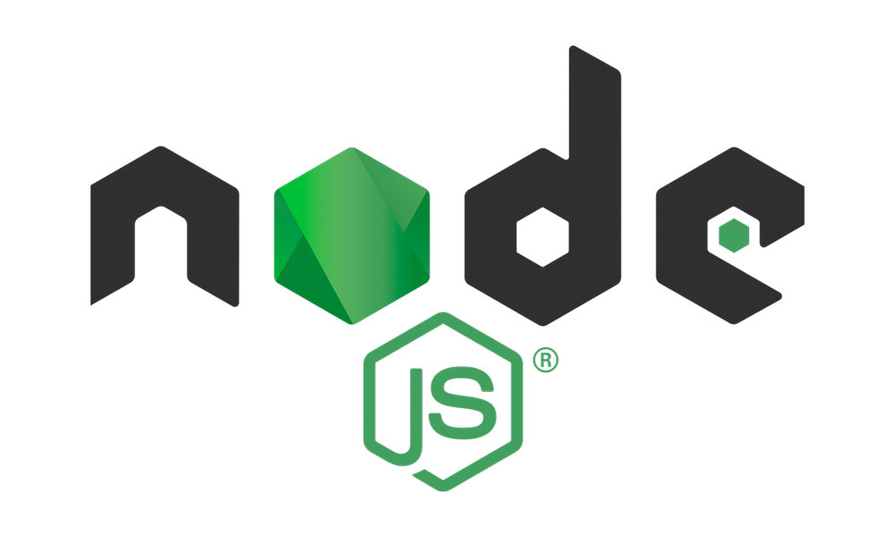
Modules in Node JS
Consider modules to be the same as JavaScript libraries.
A set of functions you want to include in your application.

Slide 2
Built-in Modules :
Node.js has a set of built-in modules which you can use without any further installation.
Include Modules :
To include a module, use the require() function with the name of the module:
var http = require('http');

Slide 3
Modules are of three types
Core Modules
Local Modules
Third-party Modules

Slide 4
Core Modules
http : Creating Server, Send Requests (Request to Other Servers as well)
https : Launch an SSL Server (Encrypt the data)
fs : used to handle file system.
path : includes methods to deal with file paths.
os : provides information about the operating system.
assert : set of assertion functions useful for testing.
process : provides information and control about the current Node.js process.
url : module provides utilities for URL resolution and parsing.

Slide 5
Local Modules
local modules are created locally in your Node.js application. Let’s create a simple calculating module that calculates various operations.
exports.add = function (x, y) {
return x + y;
};
exports.sub = function (x, y) {
return x - y;
};
exports.mult = function (x, y) {
return x * y;
};
exports.div = function (x, y) {
return x / y;
};
const calculator = require('./calc');

Slide 6
Third-party Modules
Third-party modules are modules that are available online using the Node Package Manager(NPM). These modules can be installed in the project folder or globally.
Example:
npm install express
npm install mongoose
npm install -g @angular/cli

